Slide 1
Machine Reading Comprehension
&
Question Answering System

Slide 2
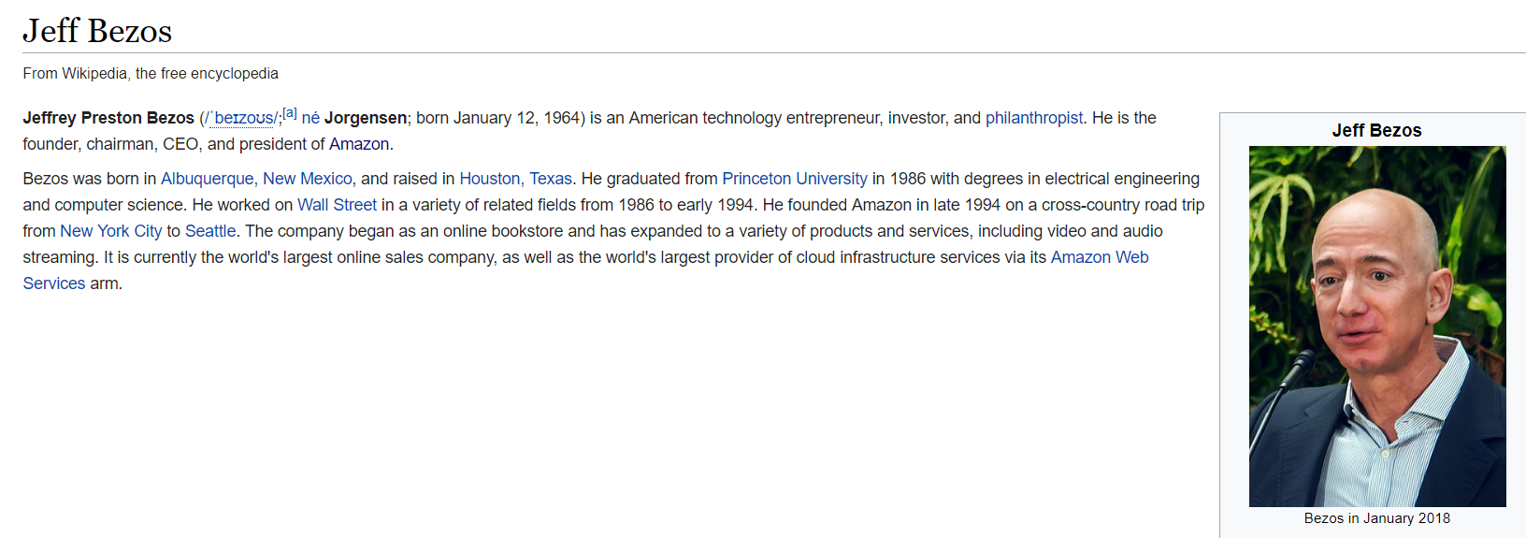

Machine reading Comprehension
What is his name?
Where was he born?
When did he found Amazon?
Why Amazon became famous?

Slide 3

Machine reading Comprehension
To answer a question, human brain need:
1. Read the information
2. Gather information, summarize
3. Infer
(Repeat x times)
n. Write down the answer
Can computers do those things?

Slide 4

Question Answering System
Hello, Sure I can
At GE3F, we developed Question Answering System (Q&A) powered by Deep Learning algorithms and
Natural Language Processing to teach machines ways to comprehend contextual text and answer questions.

Slide 5
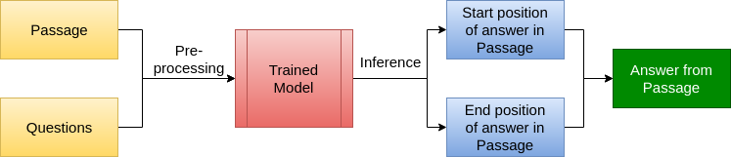
Question Answering System
Flow diagram

Slide 6
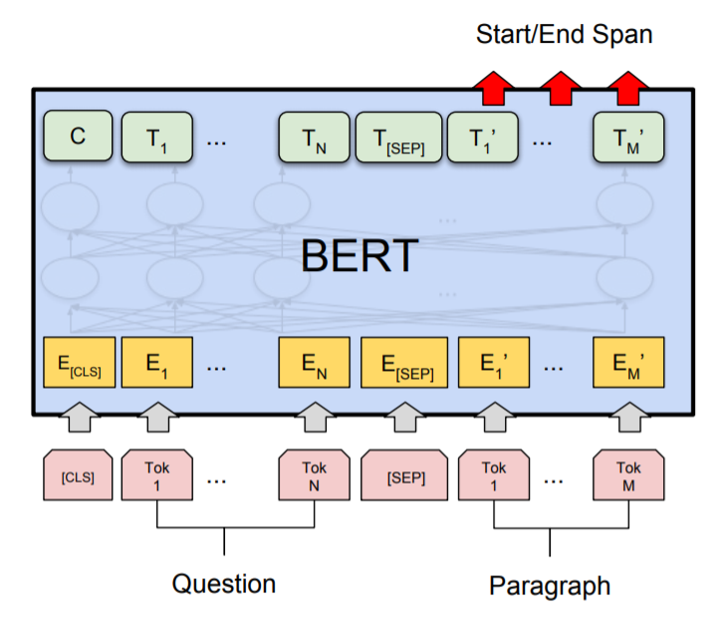
Concept Explaining
1. Principle definitions
Tok: one single word
CLS/SEP: special symbol
BERT: Bidirectional Encoder Representations from Transformers
E_{k} : Embedding vector of Tok_{k}
E_{CLS} ,E_{SEP}: Embedding vector of CLS, SEP
T : transformed matrix

Slide 7
Concept Explaining
2. Three phases of model
Phase 3: DECODING
Input: transformed matrix
Output: Start/End Span (positions)
Phase 2: ENCODING
Input: embedded matrix
Output: transformed matrix contained
Phase 1: EMBEDDED
Input: questions and passages
Output: embedded matrix

Slide 8
Pros
Q&A can apply in many fields from sport, medical to entertainment and technology
Q&A can understand difficult questions
Not just what, where, when but also how and why
Q&A immediately response in 0.5 seconds maximum

Slide 9
Cons
Problem 1: If the content is not included in the passage, Q&A can not generate the answer itself
Problem 2: the question is meaningless or not related to the passage, Q&A still return an answer (which is wrong)

Slide 10
Result on example dataset
We apply Q&A on SQuAD Dataset which consists of 107,785 question-answer pairs from 536 articles, where each answer is a text span.
F1 score: 89,13%
EM (exact match): 80%

Slide 11
Future work
To solve Problem 1, can develop a Synthesis & Generation model which takes the evidence as additional features and further elaborate the final answers.
Question
Evidences
Extraction
Synthesis
& Generation
Answer
Passage

Slide 12
Future work
Problem 2 can be solved by collecting more data to cover unanswerable question situation and retrain model.

Slide 13
THANK YOU FOR LISTENING

